Slide 1
Cognition, Language, and Creativity
Chapter 8

Slide 2
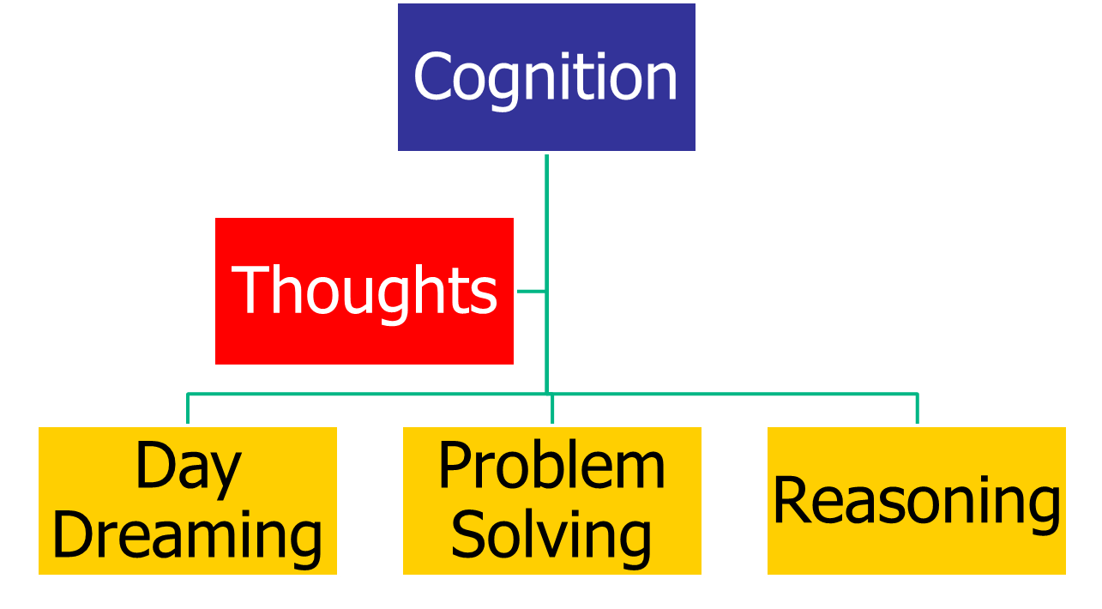
Cognition

Slide 3
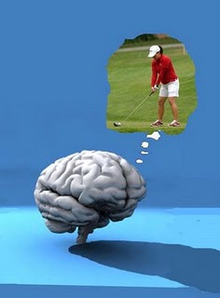
Cognition
Mental Imagery
  Think
  Remember
  Solve problems
Kinesthetic Imagery
  Michael Jordan
  Tiger Woods

Slide 4
Cognition
Using Mental Imagery to improve your life http://www.howcast.com/videos/351300-How-To-Use-Mental-Imagery-To-Improve-Your-Life
  Step 1: Separate yourself
  Step 2: Focus on the subject
  Step 3: Breathe deeply
  Step 4: State your intention
  Step 5: Express gratitude
  Step 6: Record self-talk
  Step 7: Practice anytime
  Step 8: Measure your progress

Slide 5
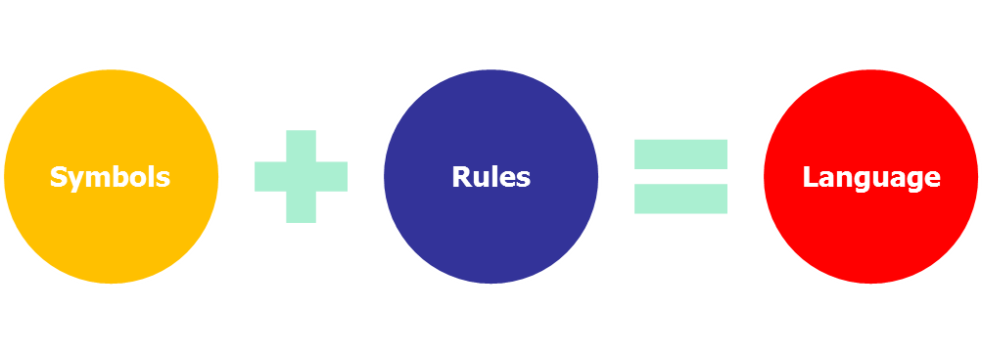
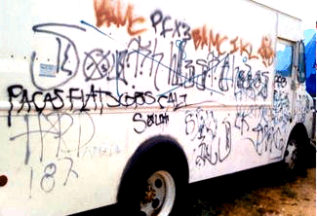
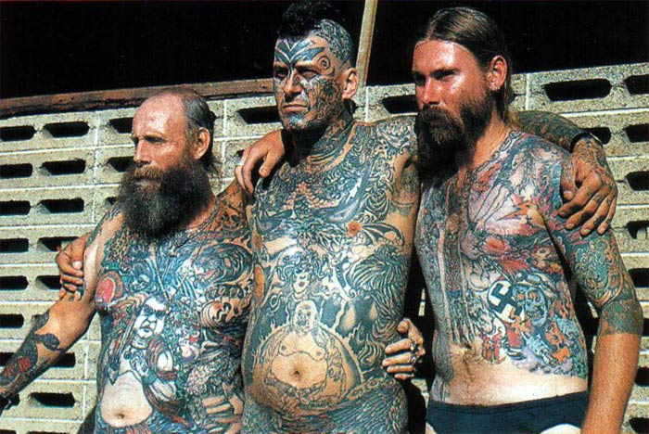
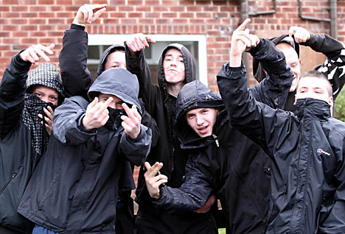
Language
The structure of language
Gang language
  Graffiti
  Signs
  Tattoos

Slide 6
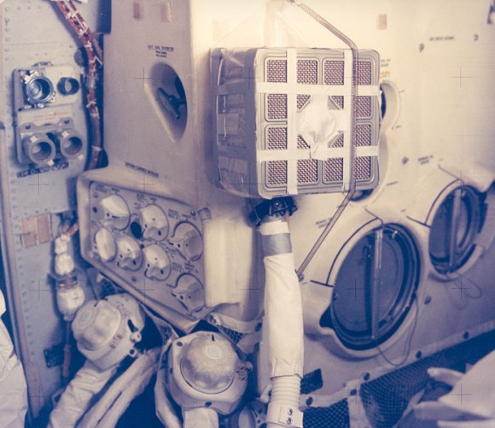
Problem Solving
Apollo 13 carbon scrubber
  Cover to the Apollo 13 flight plan (to cover and protect the hose entry)
  2 lithium-hydroxide canisters
  Roll of gray duct tape
  2 bags
  2 hoses from the red suits
  2 socks
  1 bungee cord (to secure the modified filtration device to the wall of the LM)
Obstacles (pp. 288-289)
  Functional fixedness
  Emotional barriers
  Cultural barriers
  Learned barriers
  Perceptual barriers

Slide 7

Creativity
  Stages of creative thought (page 292)
    Orientation
    Preparation
    Incubation
    Illumination
    Verification
    http://youtu.be/0k3CLHRBqW8

